Slide 1




Re-evaluating Diagnostic Criteria for Coronary Vasospastic Disorders Utilising a Novel Hydrodynamic Model
Olivia Girolamo
PhD Candidate
Principal Supervisor: Professor John Beltrame
Co-supervisors: Professor Chris Zeitz, Associate Professor Rosanna Tavella
Adelaide Medical School, The University of Adelaide
Translational Vascular Function Research Collaborative, Basil Hetzel Institute & The Queen Elizabeth Hospital

Slide 2
Background
  Established diagnostic criteria for epicardial/microvascular coronary vasospasm via ACh provocation:
    Epicardial spasm: > 90% vasoconstriction + ECG changes + chest pain
    Microvascular spasm: ECG changes + chest pain in the absence of epicardial spasm (<90% vasoconstriction)
  However, interpretation of this criteria has been variable in the literature
  Current diagnostic approach and criteria provides only a dichotomous choice between epicardial and microvascular spasm, yet the two may co-exist
Aim:
To compare ACh provocation assessment findings with coronary epicardial and microvascular resistance measures using a novel hydrodynamic model.

Slide 3
Methods
Proof-of-principle study in 48 patients with ANOCA undergoing provocative spasm testing as part of functional coronary angiography (FCA)
FCA utilised a dual sensor-tipped pressure-doppler flow wire during ACh provocation
Evaluated epicardial and microvascular resistance via a novel hydrodynamic model based on fluid mechanics
Notes:
continuous measurement of coronary blood flow velocity and pressure
Used to evaluate epicardial and microvascular resistance both pre- and post-ACh

Slide 4
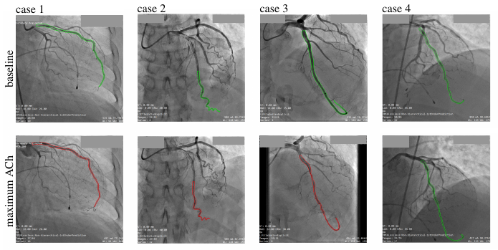
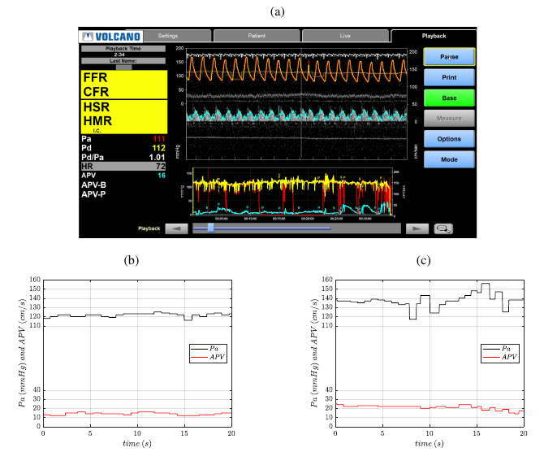
Methods- Hydrodynamic Model Development
1. Offline-analysis of Coronary Haemodynamic Indices
i) Extraction of time-series data
Blood flow velocity (Q_{a}) and arterial pressure (P_{a}) pre-ACh and post-ACh
Image processing
Calculate average diameter (D_{ave}) and length (L) of LAD for pre-ACh and post-ACh
Pre-ACh
Post-ACh

Slide 5
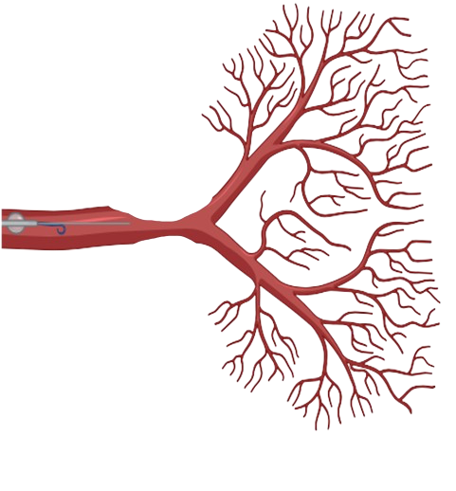
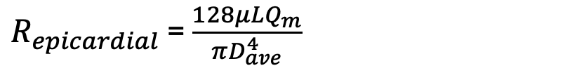
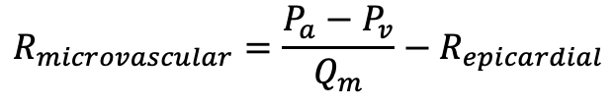
Methods- Hydrodynamic Model Development
2. Hydrodynamic Coronary Resistance Model
ComboWire
Microvascular resistance
P_{a}
$$R_{microvascular}=\frac{P_{a}−P_{v}}{Q_{m}}−R_{epicardial}$$
D_{ave}
P_{v}
L
Epicardial resistance
P_{a}= Proximal coronary pressure
P_{v}= Venous pressure (5 mmHg)
D_{ave}= Average diameter of the LAD
L= Length of LAD
µ= Blood viscosity, (3.4 mPa.s.)
Qa= Blood flow velocity
$R_{epicardial}$ = $\frac{128μLQ_{m}}{πD_{ave}^{4}}$

Slide 6
Methods- Hydrodynamic Model Development
3. Assessment of Coronary Resistance
Artery measurements from angiogram images
Flow and pressure data from ComboWire recordings
Hydrodynamic Resistance Model
Epicardial resistance for
pre and post-ACh
Microvascular resistance for
pre and post-ACh

Slide 7
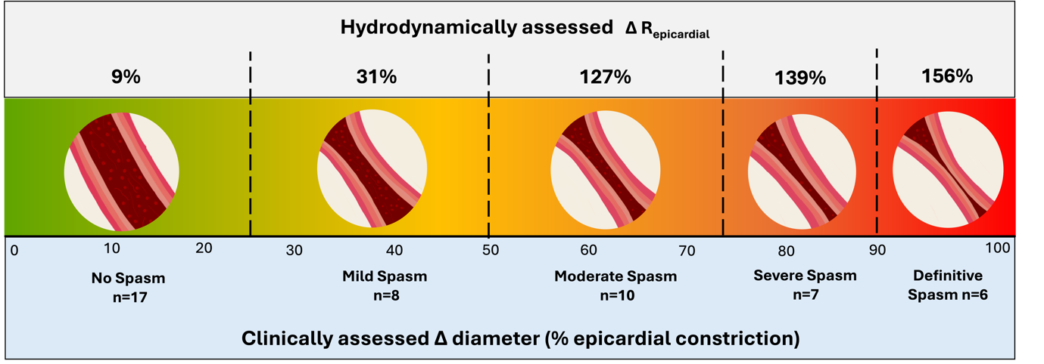
Key Findings
Severe epicardial spasm is associated with very high epicardial resistance and minimal microvascular resistance
In keeping with diagnostic criteria
“microvascular spasm” (<90% vasoconstriction) is associated with elevated epicardial resistance in 2/3 of patients
?Inappropriately classified
Isolated increased microvascular resistance was only demonstrated in one patient, who was clinically “vasospasm negative”
Subgroup of patients (23% of cohort) had combined epicardial and microvascular spasm
A novel diagnostic endotype not yet defined

